Slide 1
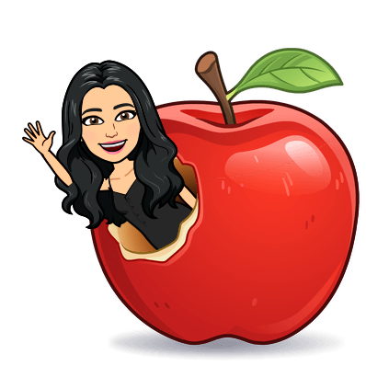
Mrs. Santos’ Distance Learning Expectations
Be on Time
Wake up early
Log on to Teams a few minutes before class
Be In A Quiet Place
Find a quiet place
Check your surroundings
Be Prepared
Computer/Phone is charged
Camera is on
Use headphones if you have them
Presentation
Wear Appropriate Clothing
Sit up straight
Be in camera view
Mute Yourself
Mute yourself when your teacher or another student is talking
Participation
Be focused
Be attentive
Be an active participant
Chat Responsibly
Raise your hand to speak
Type your questions in the chat box
Communication
Speak clearly
Look up when speaking
Stay on Topic
Be Respectful
Be kind
Be considerate

